Slide 1
Text Classification and Naive Bayes
The Task of Text Classification
Notes:
In this lecture we define the Naive Bayes classifier, a basic text classifier that will allow us to introduce many of the fundamental issues in text classification.

Slide 2
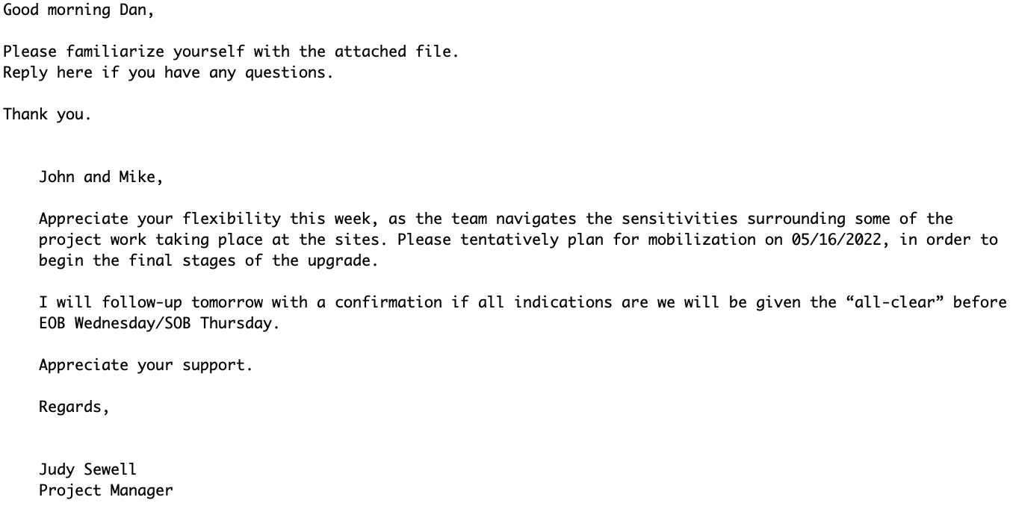
Is this spam?

Slide 3


Positive or negative movie review?
unbelievably disappointing
Full of zany characters and richly applied satire, and some great plot twists
this is the greatest screwball comedy ever filmed
It was pathetic. The worst part about it was the boxing scenes.

Slide 4
What is the subject of this article?
MeSH Subject Category Hierarchy
MEDLINE Article
Antogonists and Inhibitors
Blood Supply
Chemistry
Drug Therapy
Embryology
Epidemiology
…
?

Slide 5
Text Classification
Assigning subject categories, topics, or genres
Spam detection
Authorship identification (who wrote this?)
Language Identification (is this Portuguese?)
Sentiment analysis
…

Slide 6
Text Classification: definition
Input:
a document d
a fixed set of classes C = {c₁, c₂,…, c_{J}}
Output: a predicted class c ∈ C

Slide 7
Supervised machine learning
Machine Learning (ML) is a way of teaching computers to learn from examples instead of programming them with strict instructions.
Imagine you’re teaching a child how to recognize fruits:
If you show them many apples and bananas, they’ll eventually figure out that apples are usually round and red/green, while bananas are long and yellow.
Next time they see a new fruit, they can guess whether it’s an apple or banana based on what they’ve learned.
That’s exactly what ML does, but with computers.

Slide 8
Supervised machine learning
A simple breakdown:
Traditional programming: You tell the computer step by step what to do.
Example: “If the fruit is yellow and long → it’s a banana.”
Machine learning: You give the computer lots of examples (pictures of apples and bananas), and the computer figures out the rules by itself.

Slide 9
Classification Method: Supervised Machine Learning
Input:
a document d
a fixed set of classes C = {c₁, c₂,…, c_{J}}
A training set of m hand-labeled documents (d₁,c₁),....,(d_{m},c_{m})
Output:
a learned classifier γ:d → c

Slide 10
Classification Methods: Supervised Machine Learning
Many kinds of classifiers!
Naïve Bayes (this lecture)
Logistic regression
Neural networks
k-nearest neighbors
…
We can also use pretrained large language models!
Fine-tuned as classifiers
Prompted to give a classification

Slide 11
Text Classification and Naive Bayes
The Naive Bayes Classifier
Notes:
In this lecture we define the Naive Bayes classifier, a basic text classifier that will allow us to introduce many of the fundamental issues in text classification.

Slide 12
Naive Bayes Intuition
Simple ("naive") classification method based on Bayes rule
Relies on very simple representation of document
Bag of words

Slide 13
The Bag of Words Representation

Slide 14
Bayes’ Rule Applied to Documents and Classes
For a document d and a class c

Slide 15
Naive Bayes Classifier (I)
MAP is “maximum a posteriori” = most likely class
Bayes Rule
Dropping the denominator

Slide 16
Naive Bayes Classifier (II)
"Likelihood"
"Prior"
Document d represented as features x1..xn

Slide 17
Problems with multiplying lots of probs
There's a problem with this:
Multiplying lots of probabilities can result in floating-point underflow!
.0006 * .0007 * .0009 * .01 * .5 * .000008….
Idea: Use logs, because log(ab) = log(a) + log(b)
We'll sum logs of probabilities instead of multiplying probabilities!

Slide 18
We actually do everything in log space
Instead of this:
This:
Note: Taking log doesn't change the ranking of classes!
The class with highest probability also has highest log probability!

Slide 19
Text Classification and Naive Bayes
Sentiment and Binary Naive Bayes
Notes:
In this lecture we'll do a worked example of naïve bayes sentiment analysis, and also introduce the binary multinominal naïve bayes algorithm.

Slide 20
Let's do a worked sentiment example!

Slide 21


A worked sentiment example with add-1 smoothing
1. Prior from training:
$$\hat{P}\left(c_{j}\right)=\frac{N_{c_{j}}}{N_{total}}$$
P(-) = 3/5
P(+) = 2/5
2. Drop "with"
3. Likelihoods from training:
$$p\left(w_{i} | c\right)= \frac{count\left(w_{i},c\right)+1}{\left(\sum_{w∈V}{count\left(w,c\right)}\right)+|V|}$$
4. Scoring the test set:

Slide 22
Text Classification and Naive Bayes
Precision, Recall, and F1
Notes:
In this lecture we introduce the concepts of precision and recall, and the F1 metric that combines them. These concepts are central to the evaluation of classifiers, and we'll use them throughout NLP, not just for Naïve Bayes but also for logistic regression and neural models.

Slide 23
First step in evaluation: The confusion matrix
Notes:
The first step is the confusion matrix a table for visualizing how an algorithm performs with respect to the human gold labels, We use two dimensions (system output and gold labels), and each cell labels a set of possible outcomes.
In the pie detection case, for example, true positives are posts that are indeed about Delicious Pie (indicated by human-created gold labels) that our system correctly said were about pie. False negatives are posts that are indeed about pie but our system incorrectly labeled as pie. False positives are posts that aren't about pie but our system incorrectly said they were. And true negatives are non-pie-posts that are system correctly said were not about pie

Slide 24
Accuracy on the confusion matrix
Notes:
. Here is the equation for accuracy: what percentage of all the observations (for the spam or pie examples that means all emails or tweets) our system labeled correctly. Although accuracy might seem a natural metric, we generally don’t use it for text classification tasks.
Although accuracy might seem a natural metric, we generally don’t use it for text classification tasks.

Slide 25
Why don't we use accuracy?
Accuracy doesn't work well for unbalanced classes
Notes:
But this fabulous ‘no pie’ classifier would be completely useless, since it wouldn’t find a single one of the customer comments we are looking for. In other words, accuracy is not a good metric when the goal is to discover something that is rare, or at least not completely balanced in frequency, which is a very common situation in the world.

Slide 26
Instead of accuracy we use precision and recall
Precision: % of selected items that are correct
Recall: % of correct items that are selected
Notes:
Precision is out of the things the system selected (the set of emails or tweets the sytstem claimed were positive, i.e. spam or pie-related), how many did it get right? how many were true positives, out of what I selected (true positives _ false positives). Recall is out of all the correct items that should have been positive, what % of them did the system select? So out of all the things that are gold positive, how many did the system find as true positives? So precision is about how much garbage we included in our findings; recall is more about making sure we didn't miss any treasure.

Slide 27
A combined measure: F1
F1 is a combination of precision and recall.
Notes:
a combined measure: F-1:
Why this function instead of just the arithmetic or geometric mean? F1 turns out to be the harmonic mean between precision and recall

Slide 28
Suppose we have more than 2 classes?
Lots of text classification tasks have more than two classes.
Sentiment analysis (positive, negative, neutral) , named entities (person, location, organization)
We can define precision and recall for multiple classes like this 3-way email task:
Notes:
Lots of classification tasks have more than two classes, like sentiment could be 3-way. Consider the confusion matrix for a hypothetical 3-way email categorization decision (urgent, normal, spam). Notice that the system mistakenly labeled one spam document as urgent. We can compute distinct precision and recall values for each class. For example, the precision of the urgent category is 8 (the true positive urgents) over the true positives + false positives (the 10 normal and that 1 spam). The result, however, is 3 separate precision values and 3 separaterecall values!

Slide 29
How to combine P/R values for different classes: Microaveraging vs Macroaveraging
Notes:
To derive a single metric from these 3 sets of precisions and recalls, we can combine these in two ways. In macroaveraging, we compute the performance for each class, and then average over classes. That is, we take the same precisions and recalls we computed on the previsions slide, one set for Urgent, one set for Normal, and one set for spam, and we just average those precisions to get a single macro average.
In microaveraging, we instead first combine the decisions for all classes in a single confusion matrix, and then compute precision and recall from that table.
Note that the microaverage is dominated by the more frequent class (in this case spam), since the counts are pooled and F1 is dominated by the count of true positives. The macroaverage better reflects the statistics of the smaller classes, and so is more appropriate when performance on all the classes is equally important.

Slide 30


Questions ☺
Thanks … Grazie … شكرا … Gracias … Merci … 谢谢 (Xièxiè)

